Slide 1
Chapter Five*
Functions
*Based on Starting Out with Python by Tony Gaddis

Slide 2
Chapter Five - Functions
5.1 Introduction to Functions
5.2 Defining and Calling a Void Function
5.3 Designing a Program to Use Functions
5.4 Local Variables
5.5 Passing Arguments to Functions
5.6 Global Variables and Global Constants
5.7 Introduction to Value Returning Functions: Generating Random Numbers
5.8 Writing Your own Value-Returning Functions
5.9 The math Module
5.10 Storing Functions in Modules

Slide 3
5.1 Introduction to Functions
Most programs in the real world perform complex tasks that can be broken down into manageable subtasks
A function is a group of statements that exist within a program for the purpose of performing a specific task
Modularized program: program wherein each task within the program is in its own function

Slide 4
5.1 Introduction to Functions
Example: Breaking Calculating an Employee’s Pay into smaller tasks:
Getting the employee’s hourly pay rate
Getting the number of hours worked
Calculating gross pay
Calculating overtime pay
Calculating withholding for taxes and benefits
Calculating net pay
Printing paycheck

Slide 5
5.1 Introduction to Functions
This is known as a divide and conquer approach because large tasks are broken down into smaller tasks that are easily performed

Slide 6
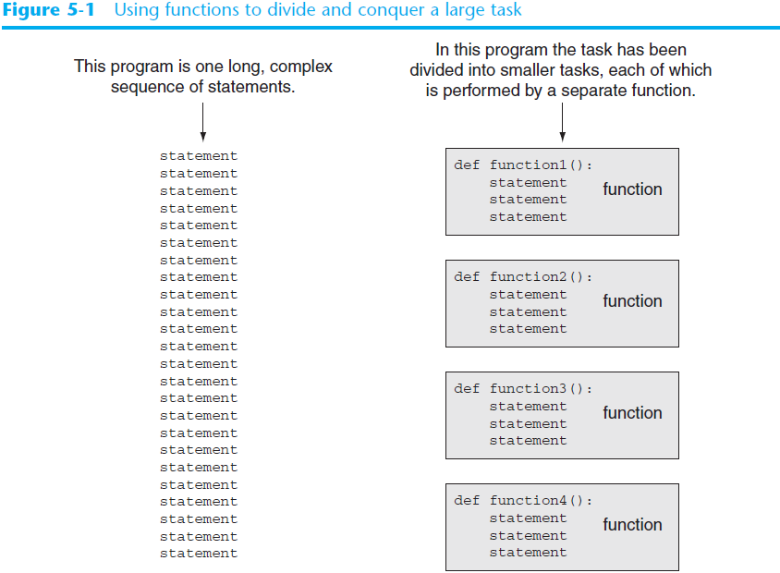
5.1 Introduction to Functions

Slide 7
Program Modularization - Benefits
Program Modularization means that a program is broken down into smaller modules or functions. Some benefits:
Simpler Code – Each program is easier to read and understand. Several small functions are much more readable than a long sequence of statements.
Code Reuse – Functions reduce the duplication of code in a program. If a specific operation is performed multiple times in the program the same code can be “re-used” multiple time
Better Testing – When each task is contained within a function, testing and debugging become simpler. Each function can be tested separately which makes it easier to isolate errors.

Slide 8
Program Modularization - Benefits
Faster Development – Functions can be written for commonly needed tasks that can be used in multiple programs in a development project
Easier Facilitation of Teamwork – When programmers work in teams, different programmers can be assigned the job of writing different functions that can be shared with other team members
Maintaining Programming Standards in a development project – Using common functions make it easier for the team to be using the same programming standards such as error handling.

Slide 9
Void Functions and Value-Returning Functions
When a void function is called, the program executes the statements within the function and then returns control to the calling function
When a value-returning function is called, the program executes the statements within the function and returns a value back to the statement that called it.
For example, the int function returns a the argument’s value converted to an integer:
new_int = int(x)
We will first learn to write void functions

Slide 10
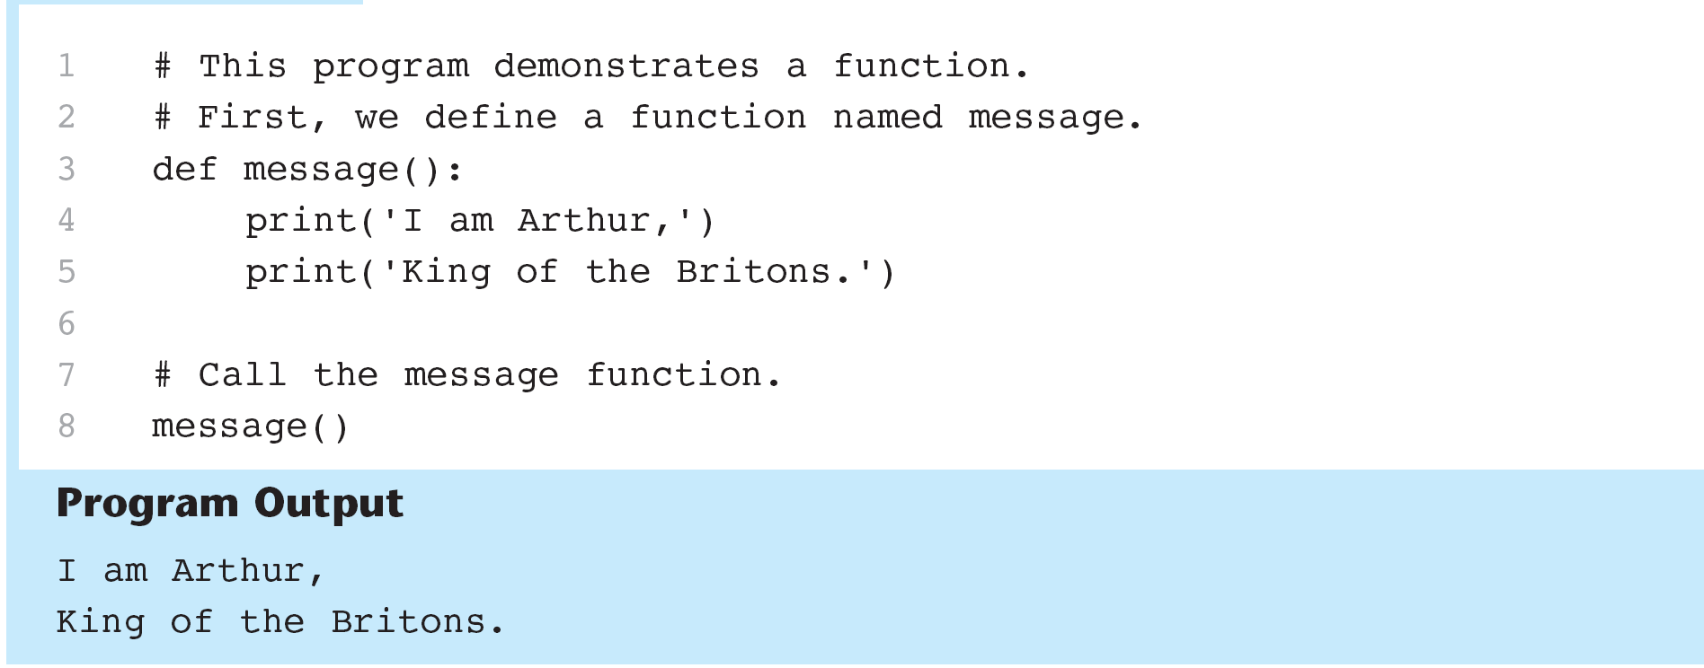
5.2 Defining and Calling a Void Function
The code for a function is known as a function definition. To execute the function, write a statement that calls it
function_demo.py

Slide 11
5.2 Defining and Calling a Void Function
Function Names – like variable names, there are rules and guidelines about naming functions
The function name should be descriptive so that anyone using your program can reasonably guess what the function does
You cannot use any of the Python’s key words (See. Table 1-2)
A function name cannot contain spaces
The first character must be one of the letters a – z, A-Z, or underscore _
After the first character you may use the letters a-z, A-Z, 0-9, or underscore

Slide 12
5.2 Defining and Calling a Function
Function names (continued)
Uppercase and lowercase characters are distinct
Because functions perform actions, it is good to use verbs to describe the action such as :
calculate_gross_pay
get_hours
get_pay_rate

Slide 13
Defining a Function
To create a function, you write its definition. The general format is:
def function_name():
statement
statement
The first line is the function header.

Slide 14
Calling a Function
The function definition specifies what should execute within the function
To execute the function itself, the function must be called
When a function is called, the interpreter jumps to that function and executes all the statements in the block
When the end of the block is reached, the interpreter jumps back or returns to the part of the program that called the function

Slide 15
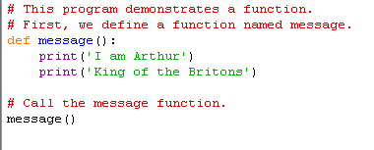
Calling a Function – Parts of a Function
Header
Block
Function
Call
All statements in the block are indented. This is required because Python uses this to determine the beginning and ending of the block.

Slide 16
Calling a Function – Runtime
1.
2.
3.
4.
Comments are ignored
Function called message is stored in memory
Comment ignored
message is executed

Slide 17
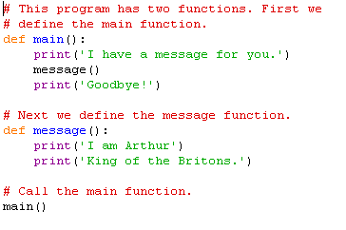
Calling Two Functions
Programs usually contain a main function which contains the mainline logic for the program

Slide 18
Indentation in Python
Each line in a block must be indented – you can use tabs or spaces but do not use both. Four spaces are typically used.
IDLE automatically indents lines in a block. When you type the colon at the end of the function header, the following lines will be indented. Press backspace to get out of the block.

Slide 19
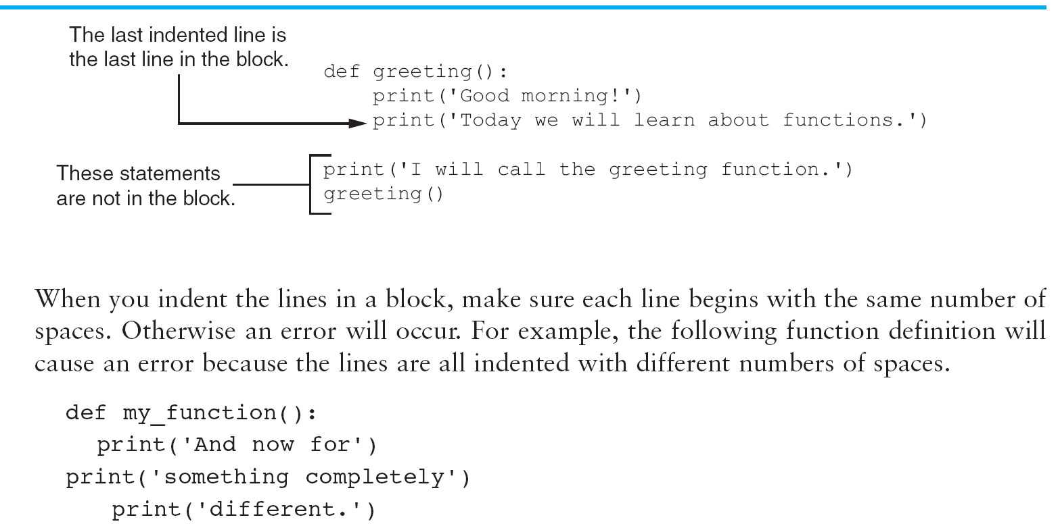
Indentation in Python

Slide 20
5.3 Program Design
Programs are frequently designed with a technique known as a top-down design. This allows algorithms to be broken down into smaller pieces that can become functions
Flowcharts are drawn for each function in the program
Function Call Symbol

Slide 21
Flowchart for Program 5-2

Slide 22
Top-down Design
Top-down Design allows algorithms to be broken down into manageable blocks that can become functions:
The overall task is broken down into a series of subtasks
Each of the subtasks is examined to determine whether it can be broken down further into more subtasks. This is repeated until no more tasks can be identified
Once all the subtasks have been identified, they are written in code

Slide 23
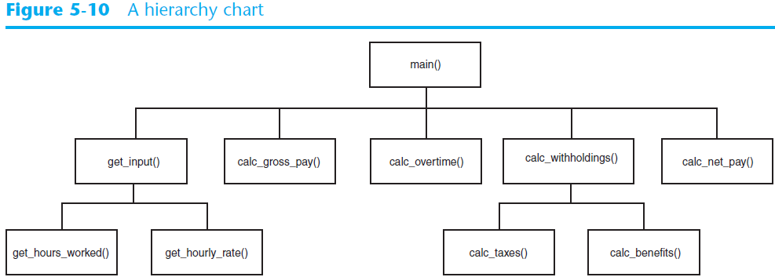
Hierarchy Charts
Hierarchy charts represent all the functions in a program
They do not show any steps being taken inside each function so they do not replace pseudocode or flowcharts

Slide 24
In the Spotlight – Defining and Calling a Function
See. Text p. 219
acme_dryer.py

Slide 25
Pseudocode (from Chapter 2)
Sometimes it is helpful to write the program in pseudo or “fake” code. It allows you to think through the program using code-like steps without having to worry about exact syntax
Each statement represents an operation to be performed in Python
Pseudocode can be later translated into actual code:
Input hours worked
Input hourly pay rate
Calculate gross pay = hours worked multiplied by pay rate
Print gross pay

Slide 26
Using Input-Process-Output Diagrams to Write Pseudocode
I
Output
Input
Process
hours worked
pay rate
read in hours worked
read in pay rate
calculate gross pay = hours worked x pay rate
display gross pay
gross pay

Slide 27
In-Class Assignment Chapter 5 Part 1.1
Instructions for making a sandwich – write a hierarchy chart for the steps needed to make a sandwich. Then write the Python program to display the steps. (See acme dryer example)
First draw the hierarchy of the functions, The main function should:
Display an intro message to the user (Ex.– “Hello this is how you make a sandwich”)
Call the step1 function
Call the step2 function
Call all remaining step functions
Display an exit message on a new line (Ex. – “Goodbye”)
Step1 function should display step1
Step2 function should display step2
Etc.
Then write the Python Program
Print when done

Slide 28
5.4 Local Variables
A local variable is created inside a function
Local variables cannot be accessed by other functions
Different functions can have variables by the same name because they cannot see each other’s local variables
An error will occur if a statement in one function tries to access a local variable that belongs to another function

Slide 29
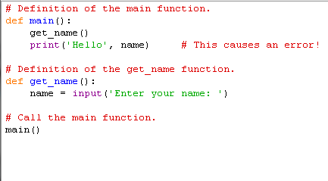
5.4 Local Variables
Open bad_local.py

Slide 30
Scope and Local Variables
A variable’s scope is the part of a program in which the variable may be accessed – the function in which it was created
A variable is visible only to statements in the variable’s scope
Also, a local variable cannot be accessed before it is created:
def bad_function():
print (‘The value is ‘, val)
val = 99
Open birds.py

Slide 31
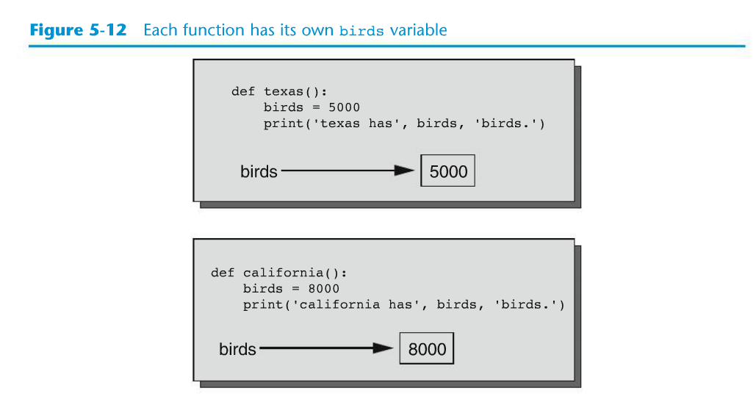
Scope and Local Variables

Slide 32
5.5 Passing Arguments to Functions
An argument is any piece of data that is passed into a function when the function is called
A parameter is a variable that receives and argument that is passed into a function

Slide 33
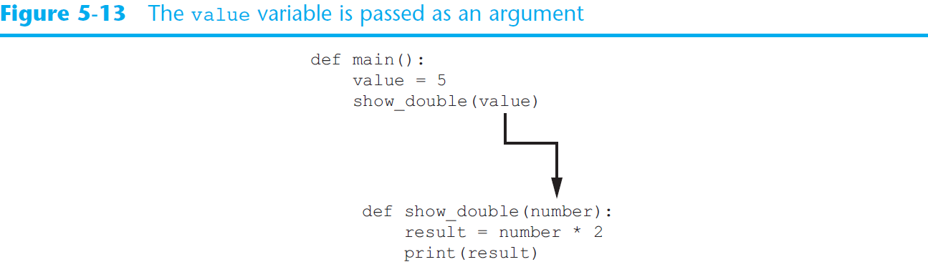
Passing Arguments to Functions (cont’d.)

Slide 34
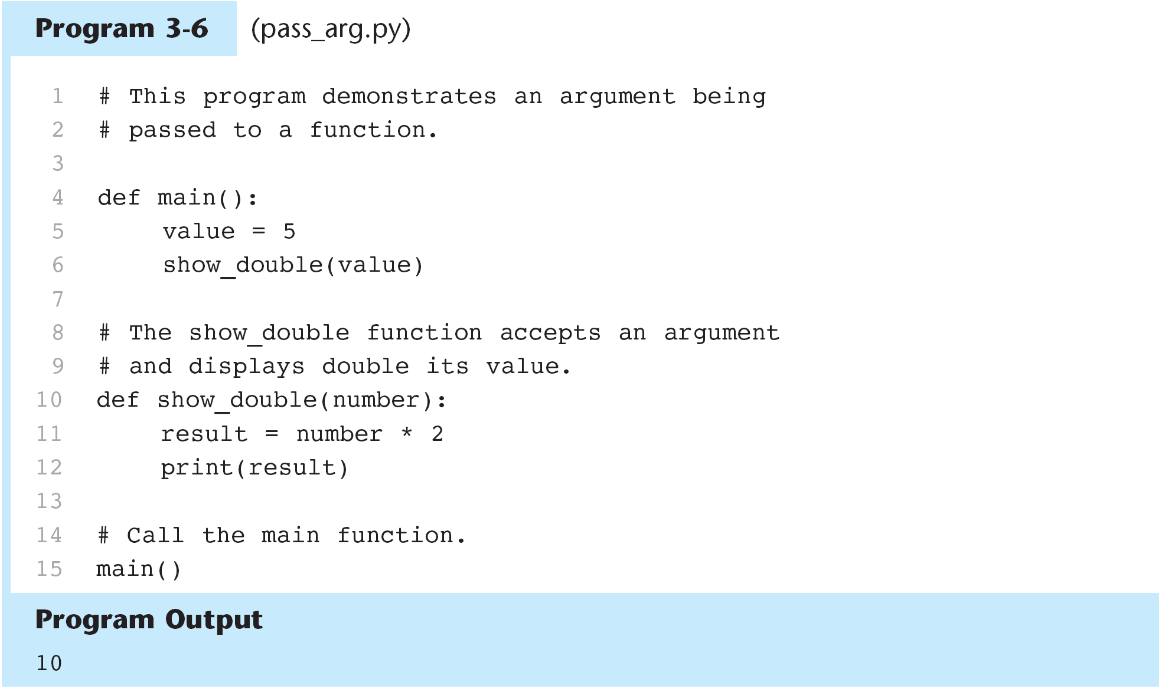
5.5 Passing Arguments to Functions
pass_args.py

Slide 35
Parameter Variable Scope
As discussed earlier, a variable’s scope is the part of the program in which the variable can be accessed
A parameter variable is a special variable that is assigned the value of an argument when a function is called
A parameter variable’s scope is the function in which the parameter is used. All of the statements inside the function can access the parameter value, but no statement outside the function can access it.

Slide 36
Passing an Argument to a Function
See text p. 228
See cups_to_ounces.py

Slide 37
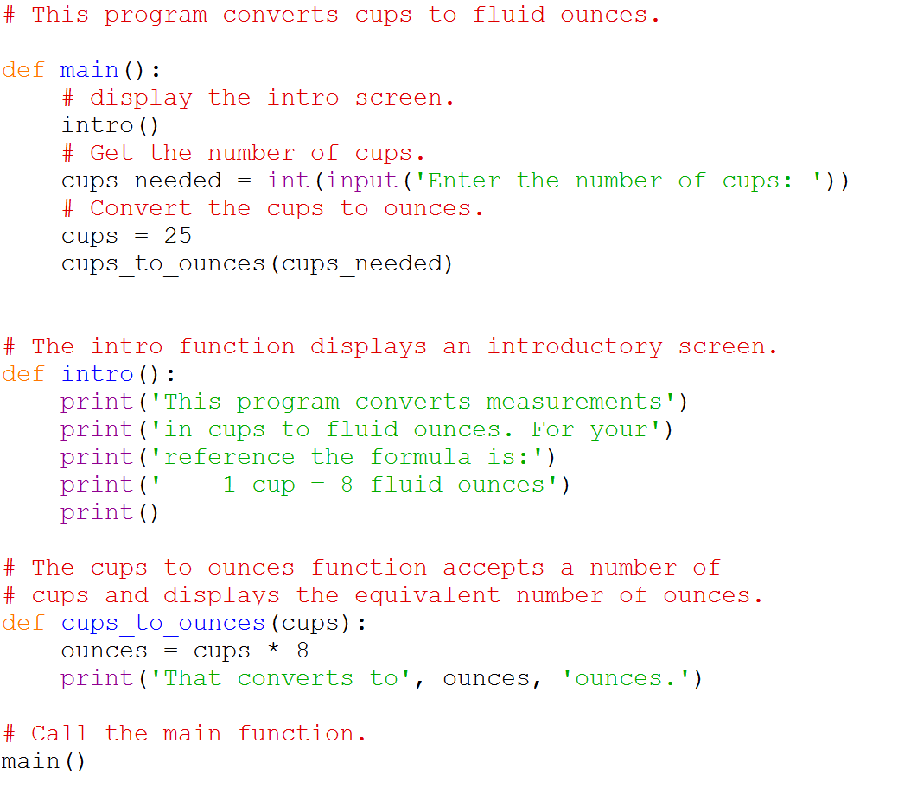

Slide 38
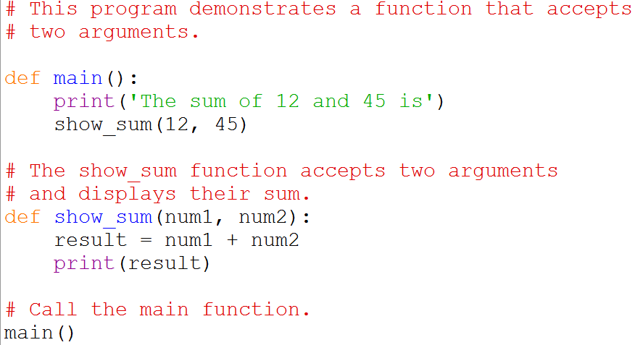
Passing Multiple Arguments
Functions can accept multiple arguments called the parameter list
Num1 and num2 are passed by position to the corresponding parameter values in the function

Slide 39
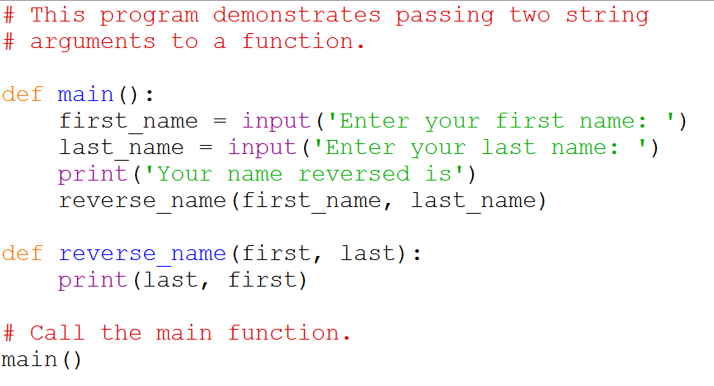
Passing Multiple Arguments - Strings

Slide 40
Making Changes to Parameters
When an argument is passed to a function in Python, the function parameter variable will reference the argument’s value. Any changes to the parameter variable will not affect the argument.
This form of argument passing used by Python where a function cannot change the value of an argument that was passed to it is called pass by value
This is a one-way communication. We will learn how to return a value later in this chapter.

Slide 41
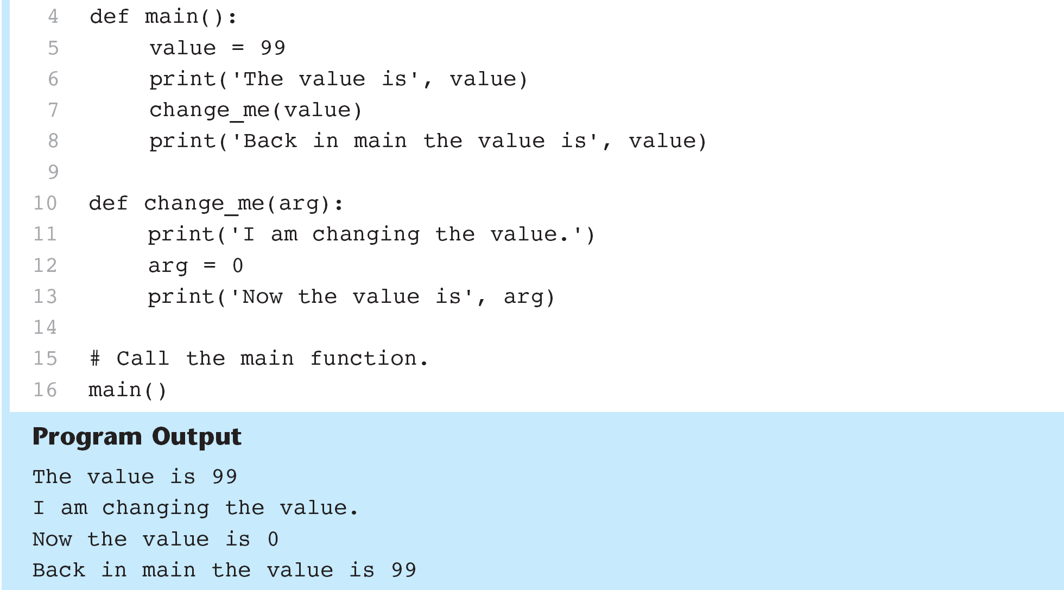
Making Changes to Parameters
change_me.py

Slide 42
Keyword Arguments
In Python, you may assign values to an argument within the function call statement these are called keyword arguments:
keyword_args.py

Slide 43
5.6 Global Variables and Global Constants
A global variable is accessible to all the functions in a program file
When a variable is created outside all the functions in a program file it is accessible by all the functions.
global1.py

Slide 44
Global Variables
If you want to assign a value to a global variable you have to declare it in a function using the global key word
global2.py

Slide 45
Global Variables
Global variables should not be used or used very sparingly:
They make debugging difficult. It can be hard to track down every statement in every function that might be changing this variable.
Functions become dependent on the global variables. This does not make functions easily reusable in other programs.
Global variables make a program hard to understand. A global variable can be modified by any function in the program so it makes it hard to understand what is going on in an individual function.
Variables should be created locally and passed as arguments to the functions that need to access them.

Slide 46
Global Constants
A global constant is a global name that references a value that cannot be changed.
There is no specific syntax in Python for global constants but they can be simulated with global variables.
You can declare a variable outside any functions but do not use the global keyword inside a function. This prevents the value from being changed.
The naming convention for global constants is ALL_CAPS. All constants should be declared at the beginning of the program.
Numeric literals (if required) in a program should ALWAYS be represented as global constants.

Slide 47
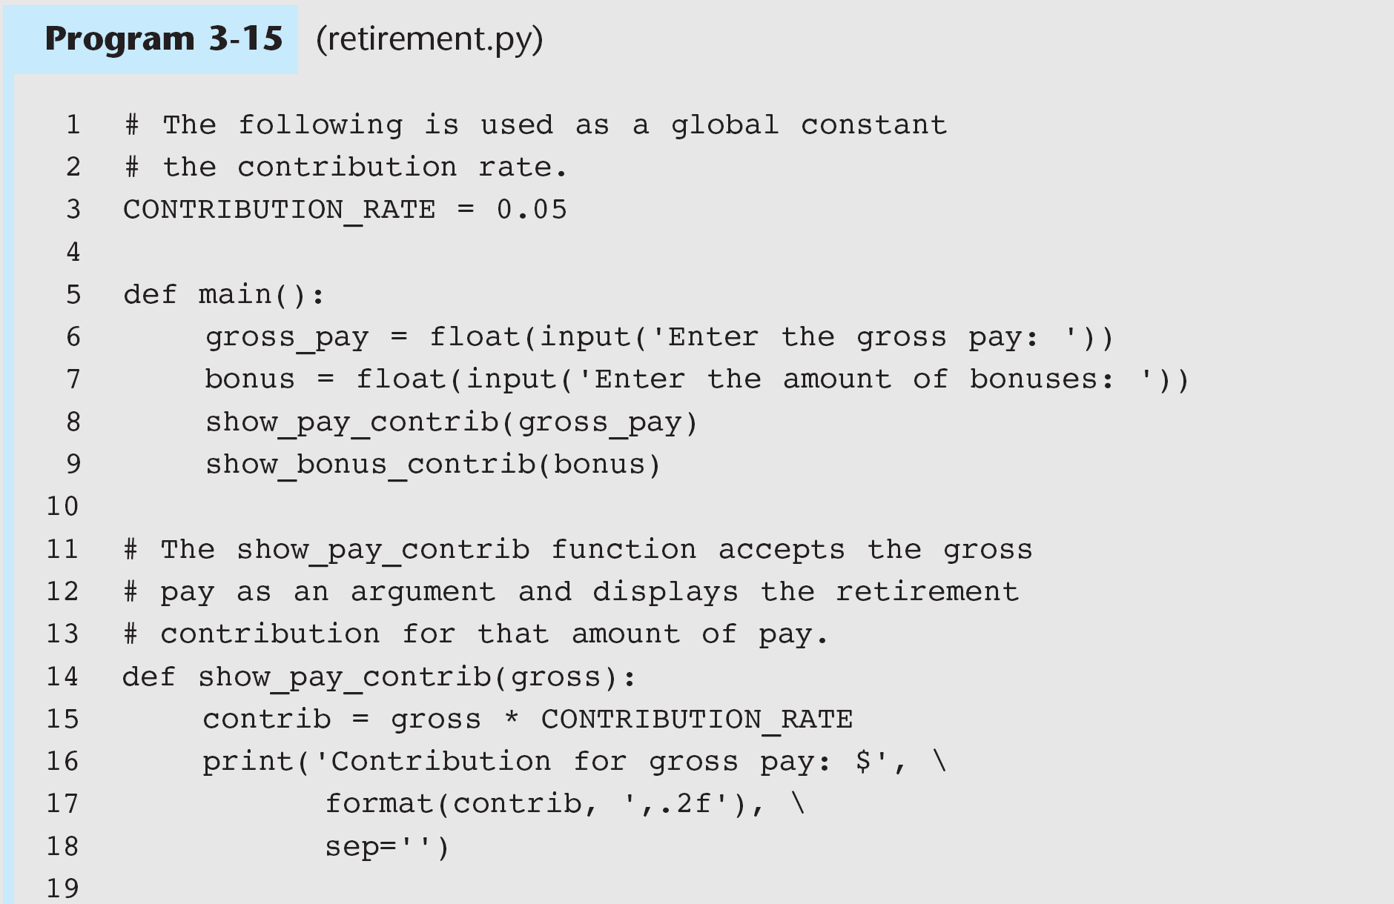
retirement.py

Slide 48
Global Variables and Global Constants
GLOBAL CONSTANTS
GLOBAL VARIABLES

Slide 49
In-Class Assignment Chapter 5 Part 1.2:
Kilometer Converter - Write a program that asks the user to enter a distance in kilometers, and then converts that distance to miles. The conversion formula is as follows:
Miles = Kilometers x 0.6214
Your program should have two functions: a main function and a function to convert and print the miles
The main function should ask the user for number of kilometers and pass that to the conversion function.
The conversion function should calculate the miles and then display to user
Use a global constant for the conversion factor
Print and turn in when you are done

Slide 50
5.7 Introduction To Value Returning Functions
A value-returning function returns a value back to the part of the program that called it
So far we learned about simple functions. A value returning function is like a simple function in that:
It is a group of statements to perform a specific task
It is called by another part of the program
However, value returning functions return a value back to the calling program
The value that is returned can be used like any other variable

Slide 51
Standard Library functions and import
Python comes with a standard library of functions that have already been written
Some have been built into the interpreter. You have already used some of these functions such as print, input, and range
Many others are stored in files called modules
Many math functions are stored in the math module
To access the math module you must add an import statement to the beginning of your program
import math
This makes all the math functions available to your program

Slide 52
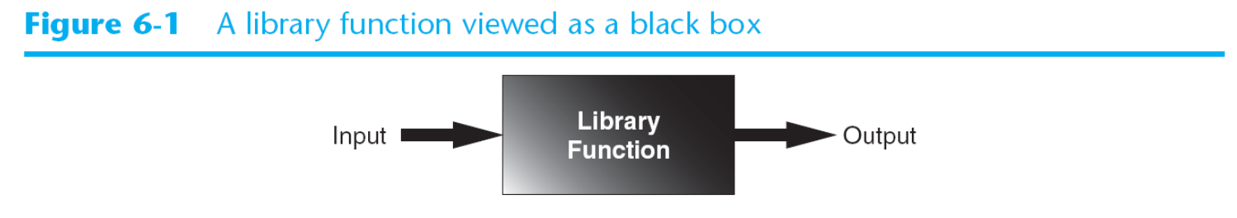
Standard Library functions and import
Library functions are often thought of as black boxes because you do not see the internal workings

Slide 53
Generating Random Numbers
Random numbers are frequently used for different programming tasks
They are commonly used in games – such as dice rolling or a shuffled deck
They are useful in simulation programs to determine how a person, animal, or insect might behave
They are useful in statistical programs to randomly select data for analysis
They are used in data security for encryption

Slide 54
The random Module
The standard library contains a module for generating random numbers called random
There are several random functions in the standard library
To use random functions import the random module
import random
This will cause the interpreter to load the random module into memory and become available to your program

Slide 55
randint
randint generates a random integer based on arguments
Since we are using the random library we must include it in our statement
For example:
number = random.randint (1,100)
This will generate a random integer in the range 1 through 100 and assign it to the variable number
Note that the call to randint is on the right side of the = operator
randint arguments include both endpoints

Slide 56
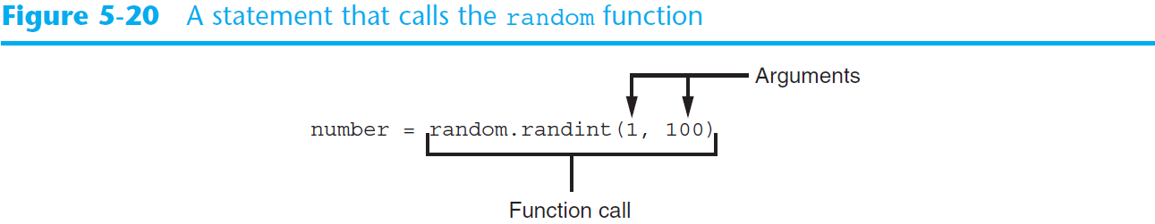
Generating Random Numbers (cont’d.)

Slide 57
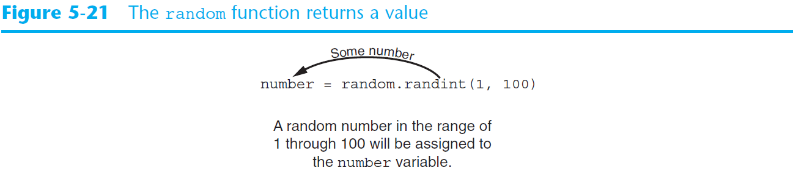
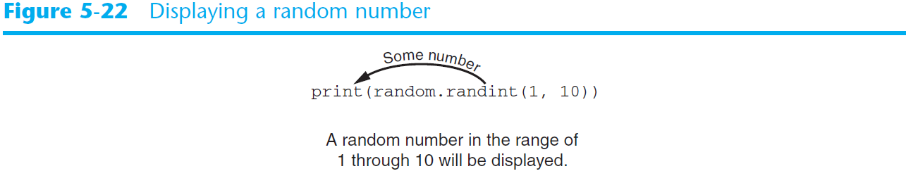
Generating Random Numbers (cont’d.)
Display one random number: Open program random_numbers.py
Display five random numbers: Open random_numbers2.py

Slide 58
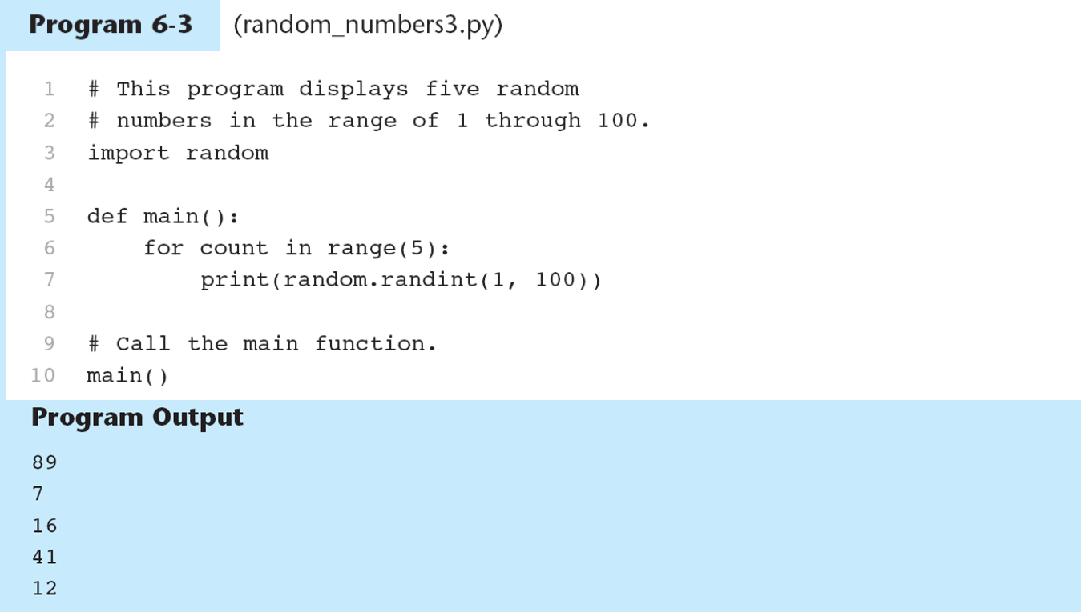
Printing a Random Number
random_numbers3.py

Slide 59
Dice Rolling Program Example
Pseudo code:
While the user wants to roll the dice:
Display a random number in the range 1 – 6
Display another random number in the range 1 – 6
Ask the user if he or she wants to roll the dice again
See dice.py, coin_toss.py

Slide 60
randrange, random, and uniform Functions
randrange works similarly to the range function except that it returns a random number
number = random.randrange (10)
Selects a random number from 0-9
number = random.randrange (5, 10)
Selects a random number from 5-9
number = random.randrange (0, 101, 10)
Selects a random number from these values:
0, 10, 20, 30, 40, 50, 60, 70, 80, 90, 100
randint and randrange return integers

Slide 61
randrange, random, and uniform Functions
The function random produces floating point numbers
number = random.random()
Returns a random floating point number between 0.0 but not including 1.0. You do not pass arguments to random
The uniform function also returns a random floating point number but allows you to specifiy a range:
number = random.uniform(1.0, 10.0)
Experiment in IDLE
import random

Slide 62
Random Number Seeds
Numbers generated by random number functions are not truly random
They are pseudo-random numbers calculated by a formula
A seed value is used to initialize the formula
When the random module is imported it uses the system time (an integer that represents current date and time) as a seed.
If the same seed were always used, the same random numbers would be generated. Since time changes, the chances of having the same seed are small.
Sometimes you may want to specify the seed instead of using the system time
random.seed(10)
See randomnumbersseed10

Slide 63
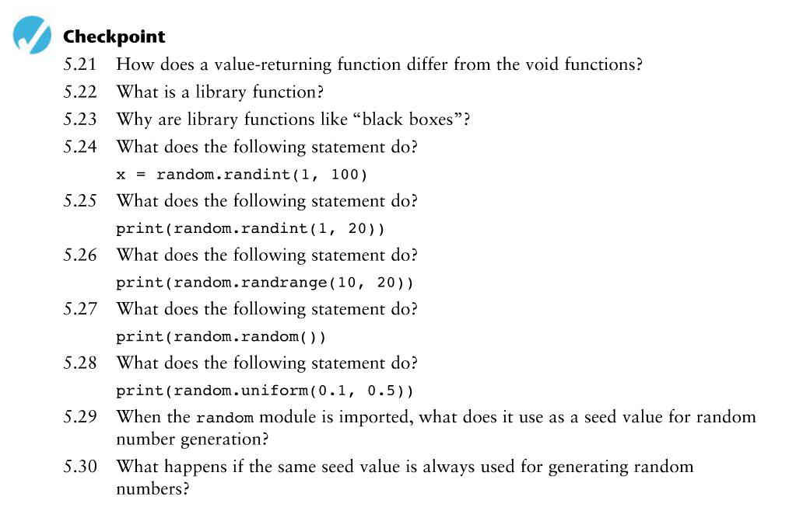

Slide 64
5.8 Writing Your Own Value Returning Functions
So far we have seen random number functions that return a value
Any function can return a value to the part of the program that called it
General format:
def function_name():
statement
statement
statement
etc.
return expression
The value of the expression that follows the key word return will be sent back to the part of the program that called the function. This can be any value, variable or expressions that has a value (such as a math expression)

Slide 65
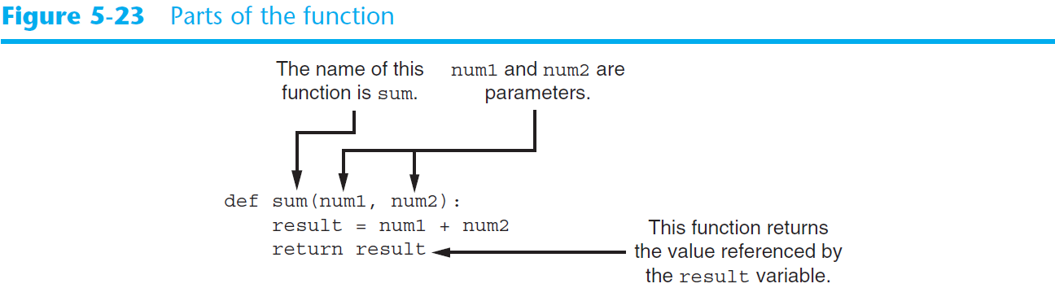
5.8 Writing Your Own Value Returning Functions
Example:
def sum(num1,num2):
result = num1 + num2
return result

Slide 66
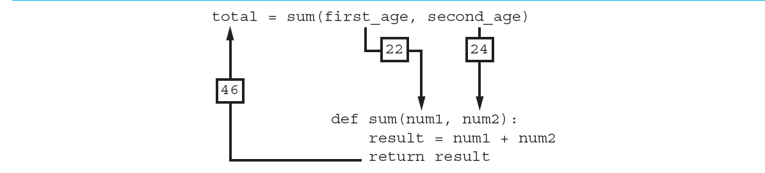
5.8 Writing Your Own Value Returning Functions
Open total_ages.py

Slide 67
Making the Most of the Return Statement
This:
def sum(num1,num2):
result = num1 + num 2
return result
Could also be written as:
def sum (num1, num2)
return num1 + num2

Slide 68
5.8 Writing Your Own Value Returning Functions
Value returning functions provide extra benefits to the advantages of breaking program into functions that we already discussed, such as modularity and lack of redundancy
You can use a value returning function to handle the user input part of your program
You can use a value returning function to perform specific calculations making your program more modular and more readable
Open sale_price.py

Slide 69
5.8 Writing Your Own Value Returning Functions
main()
discount
(regular_price)
get_regular_price()

Slide 70
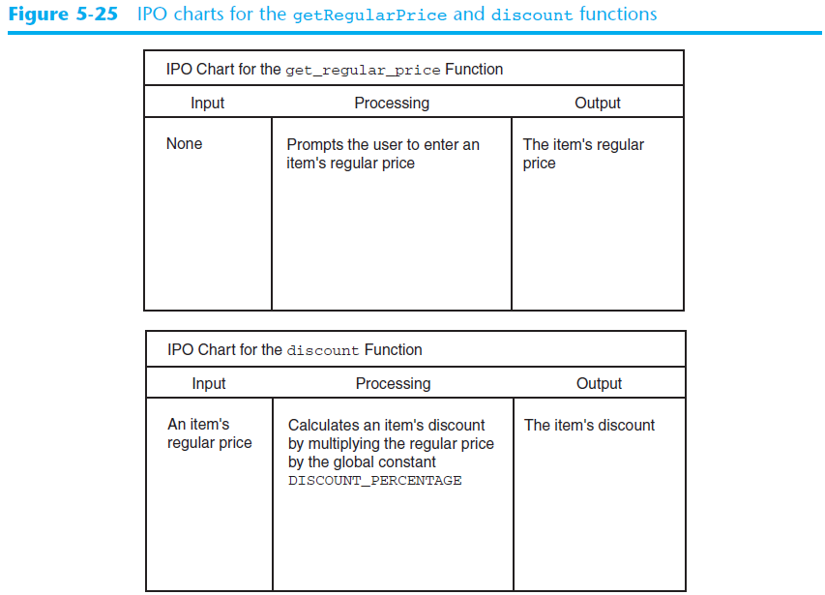
Using IPO Charts

Slide 71
Returning Strings
Functions can return strings as well as numbers
def get_name():
name = input(‘Enter your name: ‘)
return name

Slide 72
Returning Boolean Values
You can write Boolean functions that return a value of True or False. This can be a good way to test whether a condition exists:
def is_even (number):
if (number % 2) == 0:
status = True
else:
status = False
return status
The program can be written to check if the number is even:
number = int(input(‘Enter a number: ‘))
if is_even(number):
print (‘The number is even’)
else:
print (‘The number is odd’)

Slide 73
Returning Multiple Values
You can return more than one expression from a function
def get_name():
first = input (‘Enter your first name: ‘)
last = input (‘Enter your last name: ‘)
return first, last
Calling the function you need two variables to receive the two returned values:
first_name, last_name = get_name()

Slide 74
In Class Assignment Ch. 5 - 2.1
In Python, write a program to generate a random floating point number between 1 and 100 which will be used as the radius of a circle. In a separate function, calculate the area of a circle based on the radius your program just generated and return it to the main function. In the main function, display the radius and the area.
Print your program when you are done and turn it in.

Slide 75
5.9 The math module
Python’s standard library’s math module contains numerous useful mathematical functions
These functions typically accept one or more values as arguments and return the result
Most functions return a float value except the ceil and floor functions which return integers
Example:
import math
result = math.sqrt(16)
Open square_root.py
Open hypotenuse.py

Slide 76
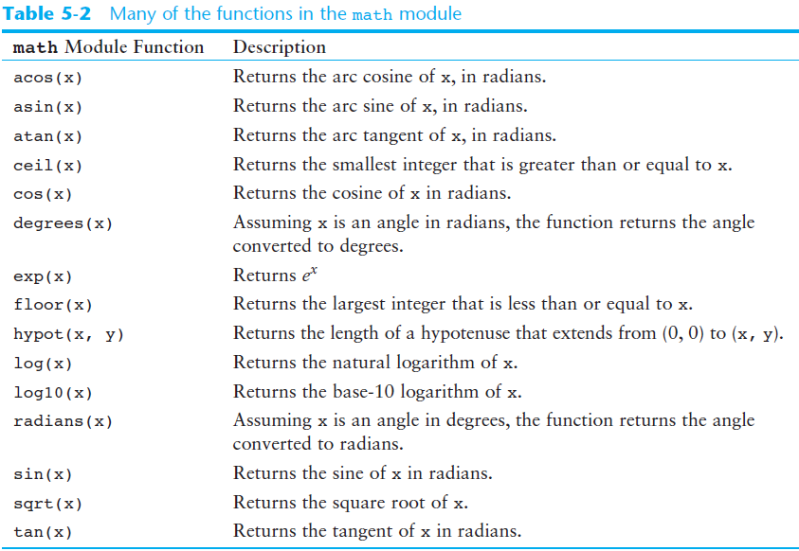
5.9 The math module

Slide 77
math.pi and math.e Variables
The math module defines two variables that can be used in equations:
math.pi
math.e (Euler’s number)
Example:
area = math.pi * radius**2

Slide 78
5.10 Storing Functions in Modules
Previously we subdivided programs into functions
A module is a function stored in a separate file
As programs become more and more complex, it is useful to organize functions by storing them in modules
Example – If you were writing an accounting system, you might store Accounts Payable functions in one module and Accounts Receivable functions in another.

Slide 79
5.10 Storing Functions in Modules – Geometry Example
We are given the task to calculate the following:
The area of the circle
The circumference of a circle
The area of a rectangle
The perimeter of a rectangle
We can break these down into two categories:
Calculations related to circles
Calculations related to rectangles
These can be stored in two separate modules
Open circle.py
Open rectangle.py

Slide 80
5.10 Storing Functions in Modules – Geometry Example
Note that files contain function definitions but do not contain code that calls the functions
This will be done by the programs that import these modules
Module naming rules:
The module’s file name must end in .py
The module’s name cannot be the same as a Python key word. An error would occur if you named a module for.

Slide 81
5.10 Storing Functions in Modules – Geometry Example
To use the module you must import it:
import circle
The Python interpreter looks for the file circle.py in the same folder as the program that is trying to import it
Once a module is imported you can call its functions
my_area = circle.area (radius)
my_circum = circle.circumference (radius)
Open geometry.py

Slide 82
Menu Driven Programs
The previous geometry program is an example of a menu-driven program
A menu-driven program displays a list of operations on the screen and allows users to select the one they wish to perform
Once the user types a menu selection, the program uses a decision structure to determine which menu item the user selected
An if-elif-else statement is used to carry out the desired action
The entire process is repeated by a while loop which repeats until the user selects option 5 (Quit)

Slide 83
In Class Assignment Ch. 5 Part 2.2
Work in groups of two. You will write a program that will calculate the area of a square based on a randomly generated integer to be used as the side.
Person 1 –write the main function which will:
Generate a random integer between 1 and 100 which will be the side of the square
Pass that number to called functions called square_area and square_perimeter.
Display the side, the returned area, and the returned perimeter.
Person 2 – in a separate file called square.py:
Define a function called square_area which will accept the side from main, calculate the square area, and returns it to main.
Define a function called square_perimeter which will accept the side from main, calculate the square perimeter, and return it to main.
Print your programs when you are done and turn in.

